Slide 1
Lymphoedema Education Group Week 2
Sub title

Slide 2
Cornerstones of Lymphoedema Care
Skin Care/ Cellulitis
Compression
Exercise
Patient Activities

Slide 3
Compression

Slide 4
What is compression?
‘the act or process of reducing the size or volume of something by pressing or squeezing’

Slide 5
Why wear compression?
Manages swelling
Soften tissues
Supports limb
Protects skin
Helps prevent cellulitis

Slide 6
Types of compression
Hosiery
Arm sleeve
Other garments
Wraps

Slide 7
Types of compression garment
Lengths - Hosiery or Armsleeve
Class
Circular knit or flat knit
Off the shelf or Made-To-Measure
Colour
Different companies

Slide 8
Which is best for me?
Chosen by your lymphoedema practitioner
Limb shape
Ability to get them on/off
Wearability

Slide 9
When to wear and remove?
The more compression is worn the better it will work
Ideally
put it on in the morning, take it off in the evening

Slide 10
What to look out for
- Pins and needles
- Numbness
- Discolouration
- Increased breathlessness
- Digging in
If you are wearing hosiery - your circulation will have been checked

Slide 11
Tips for putting on
- Rubber gloves
- Medi 2 in 1
- Butler
- Easy off

Slide 12
Washing
Can launder in a washing machine on cool wash or hand wash
Use gentle washing powder/liquid but NO fabric conditioner
Air dry on a washing line or in an airing cupboard
Cool tumble dry

Slide 13
Getting Comprssion garments
Allowed 2 pairs every 6 months
Whilst in clinic get hosiery from us
On discharge, get them on repeat prescription from your GP
Throw old hosiery away

Slide 14
Any questions on compression?

Slide 15
Movement and Exercise

Slide 16
Why Movement and Exercise Helps
Muscle Movement = Lymph Movement

Slide 17
Effects of Movement and Exercise
The muscles pump lymph fluid around the lymphatic system
Increases abdominal pressure which pumps thoracic duct
Improves general well being

Slide 18
Types of Movement and Exercise
Any movement is better than none
Any exercise is good
Should be tailored to individuals needs
Exercise on prescription
Wear compression when exercising

Slide 19
Videos
Can be seen at
Teessidehospice.org/lymphoedema
resourses section

Slide 20
Elevation
When sitting have legs and feet or arm elevated
Do gentle chair based exercises
But
Do not sit all the time
And
Do not sleep in the chair overnight

Slide 21
Any questions on Movement and Exercise?

Slide 22
Patient Self-care Activities

Slide 23
What are Self-care Activities
A set of movements that are designed to help clear lymphoedema nodes
Easy to do
Targeted to stimulate the rest of the lymphatics
Can be done sitting whilst watching TV

Slide 24
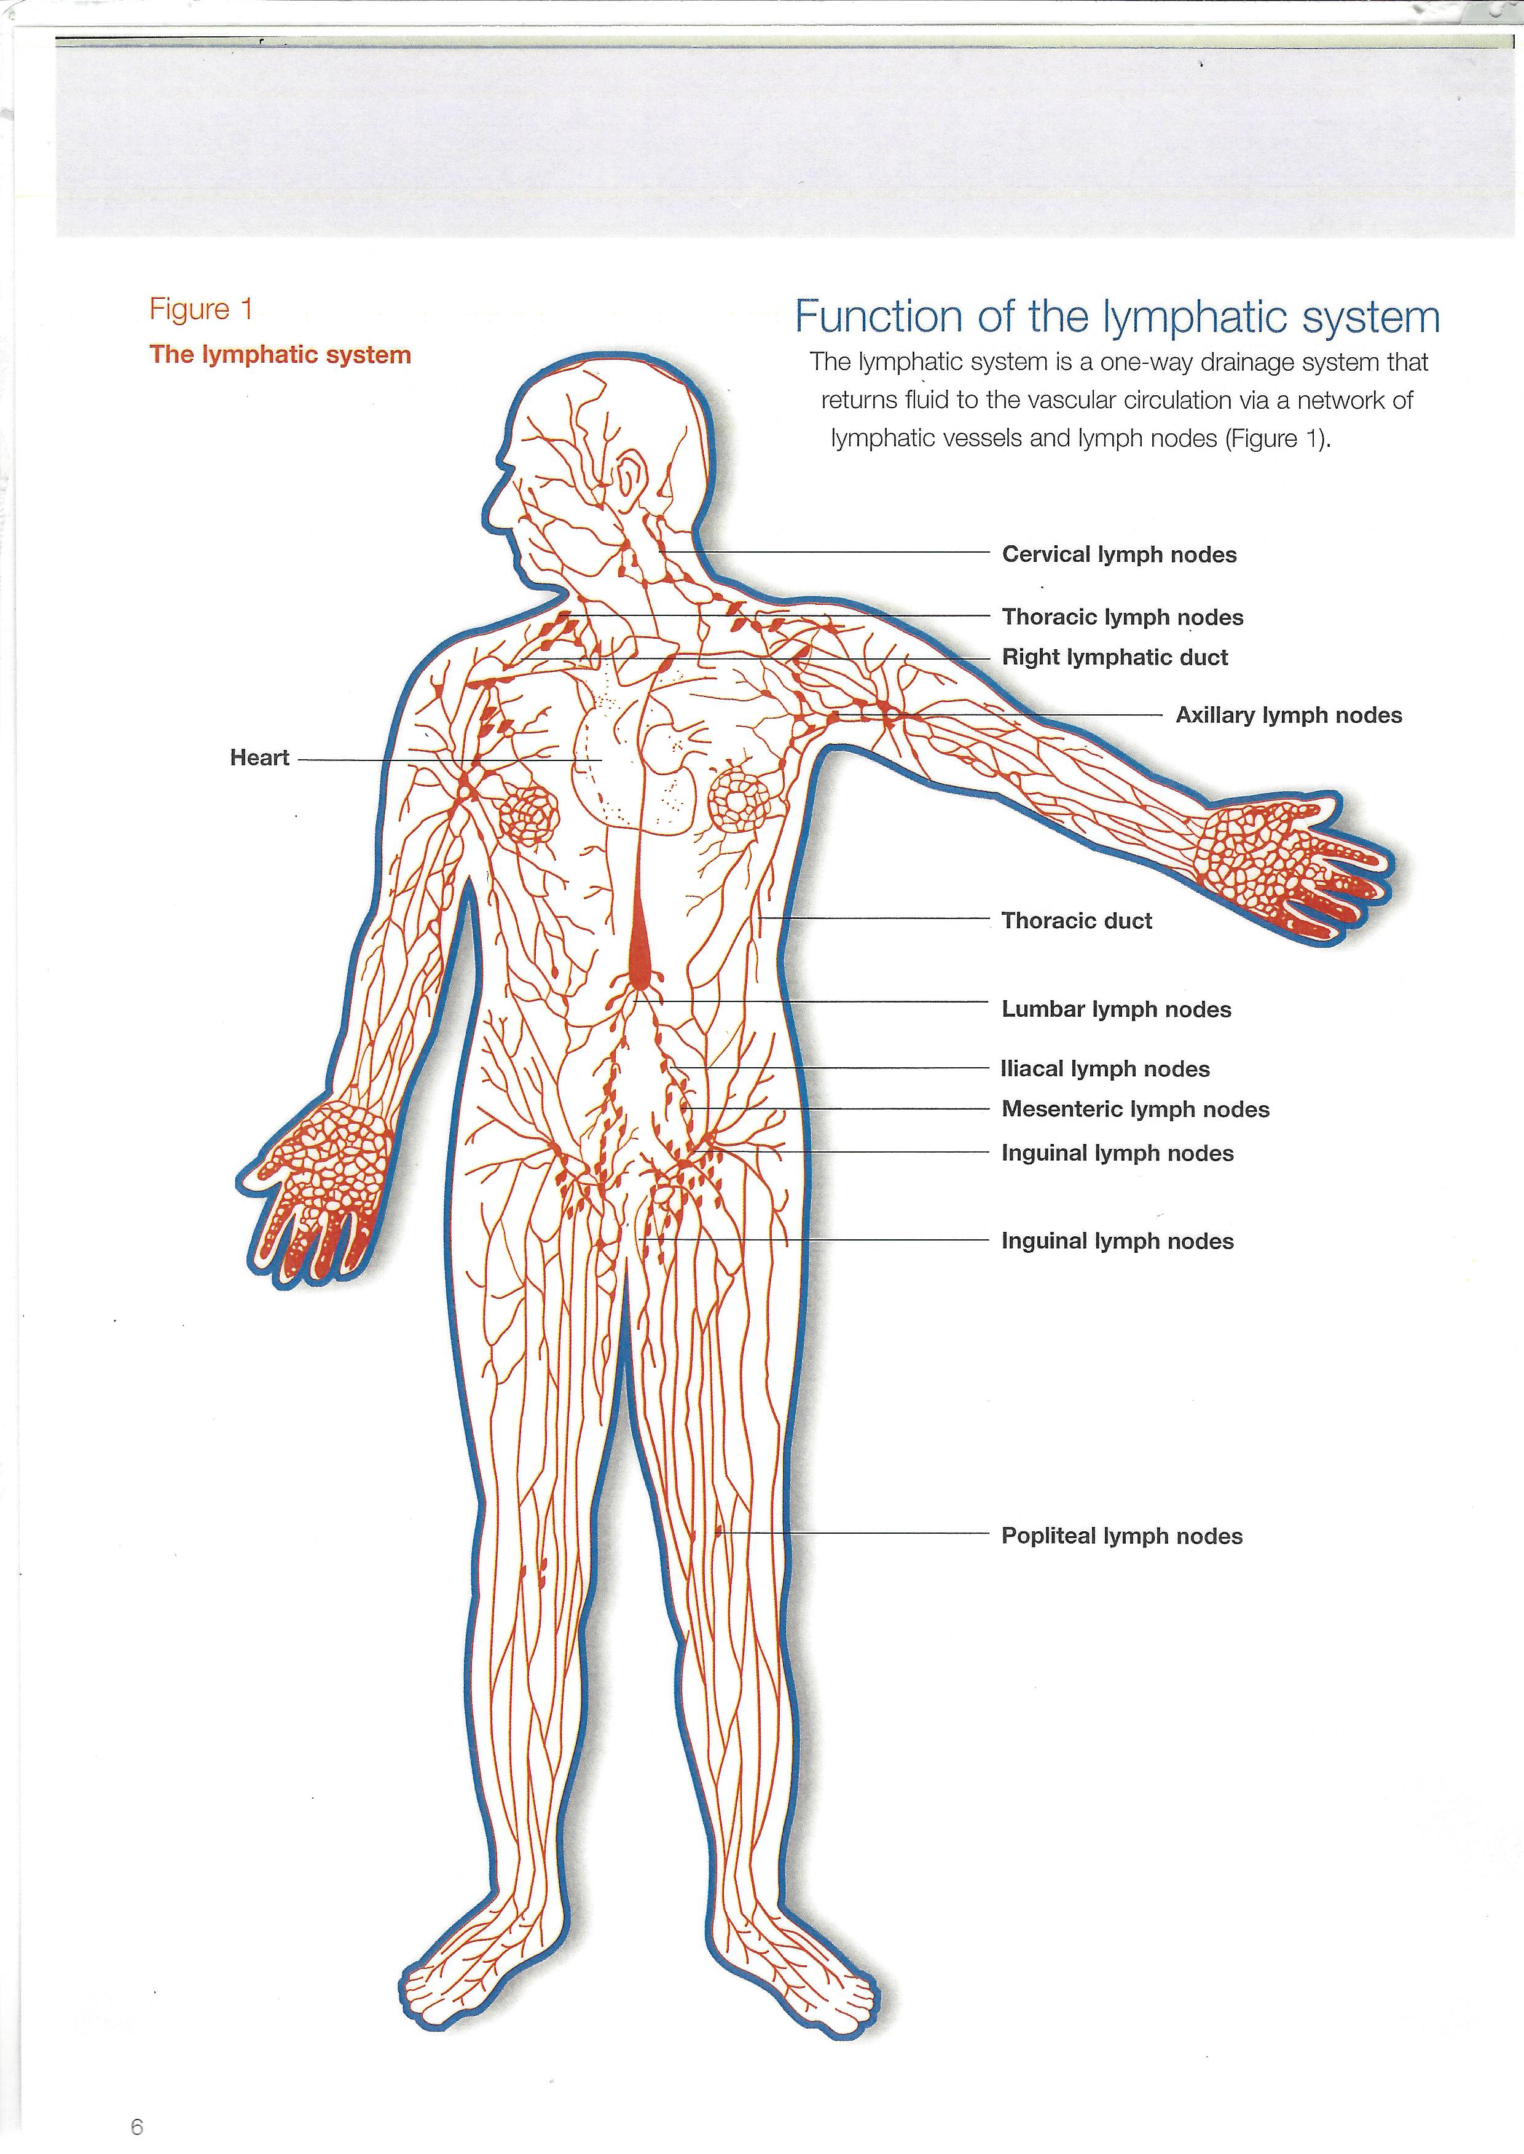

Slide 25
Video and leaflet
available on our website

Slide 26
Any Questions on Self Care Activities

Slide 27
Cornerstones of Lymphoema Care
Skin Care
Compression
Movement and Exercise
Patient Self-Care Activities

Slide 28
Other Things

Slide 29
Other Treatments
Manual Lymphatic Drainage (MLD)
Kinesio Taping
Multi Layer Bandaging (MLLB)
Pneumatic compression
Vascularised Lymph Node Transfer (VLNT) /Lympho Venous Bypass Surgery (LVB)
Liposuction (not allowed by NICE)

Slide 30
Medical Investigations
DO NOT
Have blood taken from an affected limb
Have routine injections in an affected limb
Have blood pressure taken on an affected limb
Unless there is no other option

Slide 31
What To Do on Holiday
Always travel with compression garment on
Do foot and leg exercises when travelling
Wear compression as much as possiblet, whilst away
Apply moisturiser/sun cream more regularly using skin care technique
Avoid sun burn by using high factor sun cream
Observe for cuts, insect bites and signs of infection
Take ‘in-case’ antibiotics on holiday with you

Slide 32
Any Questions?

Slide 33
Conclusion
Make the cornerstones of lymphoedma care part of your everyday routine

