Slide 1
Lymphoedema Patient Education Group Week 1

Slide 2
Introduction

Slide 3
Why Teesside Hospice?

Slide 4
The aim of these sessions is to increase your knowledge of lymphoedema and how to manage it yourself.

Slide 5
How this clinic will help you?
Attend Patient Admission Group
Initial assessment
Review assessment (4-5 weeks later)
Attend Patient Education Group
Review assessment (3 months later)
Review assessment and discharge (3-6 months later)

Slide 6
3 Sessions
Week 1 - What is lymphoedema? - Skin care - Cellulitis
Week 2 - Exercise/movement - Patient Activities - Compression
Week 3 - Management of a Chronic Condition

Slide 7
What is Lymphoedema?
Lymphoedema is a progressive chronic condition that affects a significant number of people and can have deleterious effects on patients' physical and psychosocial health.
International Consensus Document –
Best Practice for the Management of Lymphoedema

Slide 8
Lymphoedema
Lymph – the fluid in the lymphatic system
Oedema – swelling caused by fluid

Slide 9
Functions of The lymphatic system
Transports lymph around the body
Sewerage system of the body
Part of the Auto-immune system

Slide 10
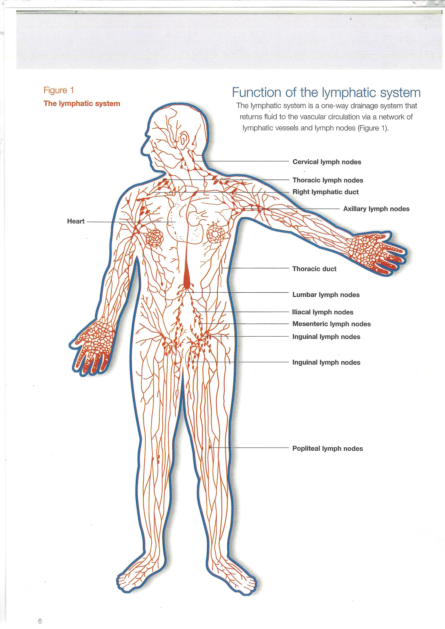

Slide 11
Types of Lymphoedema
Filariasis
Primary Lymphoedema
Secondary Lymphoedema
Chronic Oedema/Gravitational Oedema
Lipoedema

Slide 12
Terms used in lymphoedema
Skin
Tissues
Erythema
Hyperkeratosis
Papillomatosis
Pitting
Doughy
Fibrosed

Slide 13
Cornerstones of Lymphoedema Care
Skin Care
Compression
Exercise
Patient Activities

Slide 14
Skin Care

Slide 15
Why do skincare?
Keeps skin moisturised
Allows skin to stretch
Prevents skin condition getting worse
Prevents cellulitis

Slide 16
Looking after your skin
Washing and drying
Wash affected limb regularly and dry thoroughly
Ensure all skin folds and between toes or fingers are clean and dry
Monitor for cuts, scratches, insect bites or any signs of cellulitis

Slide 17
How to do skin care
Apply moisturiser 1-2 times a day
Using a very gentle stroking action
Always stroke upwards toward the body
Start closest to the body and work away

Slide 18
Arm

Slide 19
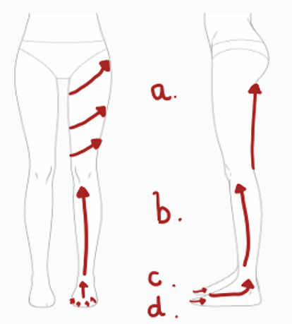
Leg

Slide 20
What ceams to use
Washing skin
Any soap substitute or body wash (as long as it doesn’t cause irritation)
Dermol 500 lotion (do not use all the time)
Moisturiser
Doublebase, Cetraben or Hydromol
Aveeno

Slide 21
Aids to doing skin care
Drying
Use hairdryer to dry between toes and in skin folds
Moisturising
Use paintbrush or paint roller to apply moisturiser

Slide 22
Video and leaflets can be seen on the website teessidehospice.org/lymphoedema

Slide 23
Warning
Skin products containing paraffin based products in contact with clothing are easily ignited with a naked flame or cigarette

Slide 24
Any questions on skin care?

Slide 25
Cellulitis

Slide 26
What is cellulitis?
A sudden, non contagious infection of the skin caused by a bacterial infection
(usually Streptococcus)
People with lymphoedema are at an increased risk because
A collection of protein rich lymph fluid
Impaired lymphatic system doesn’t fight infection

Slide 27
Symptoms
Pain
Heat
Increased swelling
Blistering or leaking (lymphorrhoea)
Flu-like symptoms, chills, fever, headache, nausea/sickness
Symptoms can vary between each person

Slide 28
What causes cellulitis?
cuts, scratches and insect bites
ulcers or wounds
leaking/maceration
fungal infection of toes or nails
BUT there may not be a cause

Slide 29
Treatment for Cellulitis
Contact your doctor immediately you suspect cellulitis
Stop it before it gets worse
If left may damage the lymphatics more
Potential risk of sepsis

Slide 30
Antibiotics
2 weeks course of antibiotics
(may need longer)
Evidence from the Lymphoedema Support Network
‘The Cellulitis Consensus Document’

Slide 31
Which antibiotics?
Flucloxacillin 500mg-1000mg four times a day
or
Clarithromycin 500mg twice a day
if allergic to penicillin
or
Doxycycline 100mg twice a day
If allergic to penicillin and on statins

Slide 32
Other treatment
Remove any compression for a few days
Stop any other lymphoedema treatments
Elevate limb
Drink plenty of water
Painkillers/Paracetemol as needed
Rest

Slide 33
Prevention
Skin care
Care when cutting nails (podiatry)
Do not walk around barefoot
Don’t get sunburn
Wear well fitting clothes and shoes
Electric razor for hair removal

Slide 34
Long term antibiotics
If 2 or more episodes of cellulitis in a year
Penicillin V (phenoxymethylpenicillin) or clarithromycin
Can be discontinued after 1 year if no further episodes but may be life long
need to stop them when taking a 2 week course of antibiotics, then restart again

Slide 35
In-case’ Antibiotics
Patients may carry a 2 week course of antibiotics at home or if going on holiday
Antibiotics to be started immediately symptoms of cellulitis develop
Medical opinion should be sought as soon as possible
At the discretion of the GP

Slide 36
Any questions on cellulitis?

Slide 37
Any questions on cellulitis?

Slide 38
Support for you
Contact the clinic
On-line
Teessidehospice.org/lymphoedema
Lymphoedema Support Network (LSN)
Legs Matter (legsmatter.org)
British Lymphology Society (BLS)
Facebook/Twitter

Slide 39
Conclusion
Include skin care as part of your normal daily routine

